Slide 1
Chapter 5:
Methods
Starting Out with Java:
From Control Structures through Objects
Fourth Edition
by Tony Gaddis
Notes:
CHAPTER 5
Java Gaddis 4e

Slide 2
Chapter Topics
Chapter 5 discusses the following main topics:
  Introduction to Methods
  Passing Arguments to a Method
  More About Local Variables
  Returning a Value from a Method
  Problem Solving with Methods
5-<number>
Notes:
CHAPTER 5
Java Gaddis 4e

Slide 3
Why Write Methods?
Methods are commonly used to break a problem down into small manageable pieces. This is called divide and conquer.
Methods simplify programs. If a specific task is performed in several places in the program, a method can be written once to perform that task, and then be executed anytime it is needed. This is known as code reuse.
5-<number>
Notes:
CHAPTER 5
Java Gaddis 4e

Slide 4
void Methods and Value-Returning Methods
A void method is one that simply performs a task and then terminates.
String name = "Joe Smith";
System.out.println("Hi " + name + "!");
  It doesn't give back (return) an answer.
  It would be inappropriate (and Illegal) to use it on the right side of an assignment
x = System.out.println("Hi " + name + "!");
  This will not compile!
5-<number>
Notes:
CHAPTER 5
Java Gaddis 4e

Slide 5
void Methods and Value-Returning Methods
A value-returning method not only performs a task, but also sends a value back to the code that called it.
int number = Integer.parseInt("700");
  The answer is usually used in some way:
    Assign it to a variable x = Math.sqrt(y);
    Compare it to something if( Math.sqrt(y) > 10.0 )
    Use it in a calculation z = 2 * Math.sqrt(y);
5-<number>
Notes:
CHAPTER 5
Java Gaddis 4e

Slide 6
void Methods and Value-Returning Methods
A value-returning method not only performs a task, but also sends a value back to the code that called it.
  Calling a value-returning method without doing something with the value it returns is not productive
  Math.sqrt(y);
  This returns a value, but doesn't do anything with it... So what is the point???
5-<number>
Notes:
CHAPTER 5
Java Gaddis 4e

Slide 7
Defining a void Method
To create a method, you must write a definition, which consists of a header and a body.
The method header, which appears at the beginning of a method definition, lists several important things about the method, including the method’s name.
The method body is a collection of statements that are performed when the method is executed.
5-<number>
Notes:
CHAPTER 5
Java Gaddis 4e

Slide 8
Sample Method Definition
Header
public static void displayMesssage()
{
System.out.println("Hello");
}
Body
5-<number>
Notes:
CHAPTER 5
Java Gaddis 4e

Slide 9
Parts of a Method Header
Method Modifiers
Return Type
Method Name
Parentheses
public static void displayMessage ()
{
System.out.println("Hello");
}
5-<number>
Notes:
CHAPTER 5
Java Gaddis 4e

Slide 10
Parts of a Method Header
Method modifiers:
  For now, we will use them without much explanation. They are explained more thoroughly in later chapters.
    public – method is publicly available to code outside the class
    static – method belongs to a class, not a specific object.
Return type – void or the data type from a value-returning method.
Method name – name that is descriptive of what the method does. Use case as for variables.
Parentheses – contain nothing or a list of one or more variable declarations if the method is capable of receiving arguments.
5-<number>
Notes:
CHAPTER 5
Java Gaddis 4e

Slide 11
Calling a Method
A method executes when it is called.
The main method is automatically called when a program starts, but other methods are executed by method call statements.
displayMessage();
Notice that the method modifiers and the void return type are not written in the method call statement. Those are only written in the method header.
Examples: SimpleMethod.java, LoopCall.java, CreditCard.java, DeepAndDeeper.java
5-<number>
Notes:
CHAPTER 5
Java Gaddis 4e

Slide 12
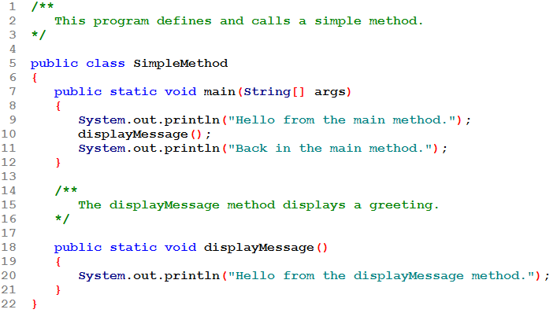
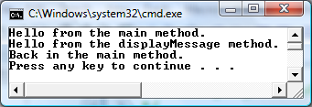
METHOD CALL
METHOD HEADER
When the displayMessage(); statement executes, control transfers to the method. Its body executes. When the end of the method is reached, control returns to the statement that follows the method call.

Slide 13
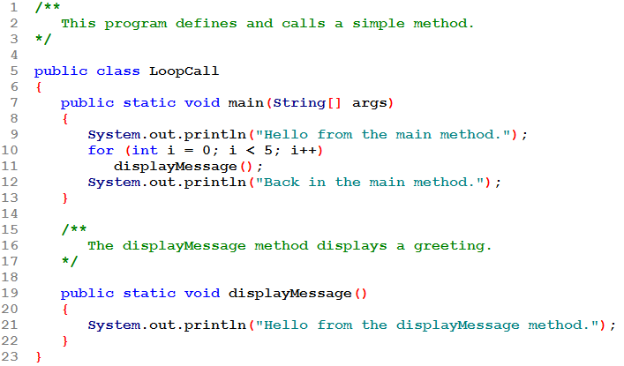
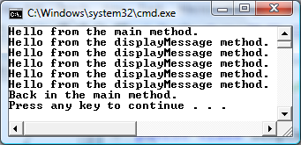
A method can be called from inside a loop, if statement, switch, ....

Slide 14
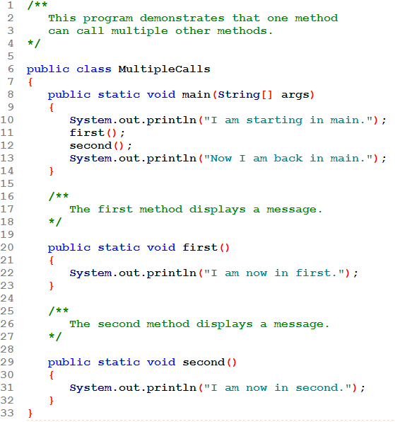
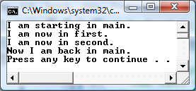
Method main() calls two methods: first() and second().

Slide 15
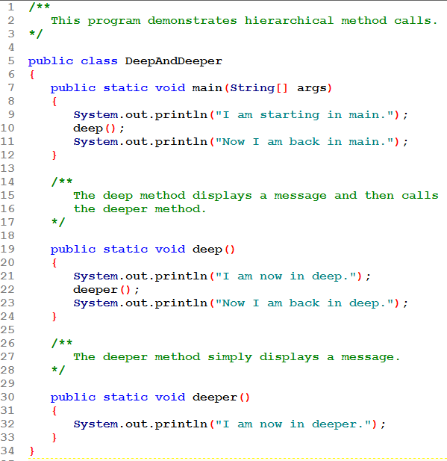
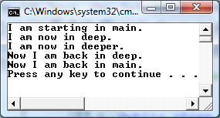
Methods can be called in a hierarchical/layered fashion: A calls B which calls C. When a method finishes, control reverts to its caller. So when C finishes, control goes back to B and when B finishes, control goes back to A.

Slide 16
Documenting Methods
A method should always be documented by writing comments that appear just before the method’s definition.
The comments should provide a brief explanation of the method’s purpose.
The documentation comments begin with /** and end with */.
Be sure you do this for all methods!
5-<number>
Notes:
CHAPTER 5
Java Gaddis 4e

Slide 17
Passing Arguments to a Method
Values that are sent into a method are called arguments.
  System.out.println("Hello");
  number = Integer.parseInt(str);
  c = Math.pow(x, y);
  "Hello", str, x and y are arguments
Variables defined in the method header that hold the value passes as arguments are called parameters.
5-<number>
Notes:
CHAPTER 5
Java Gaddis 4e

Slide 18
A Method with a Parameter Variable
public static void displayValue(int num)
{
System.out.println("The value is " + num);
}
The integer variable num is a parameter.
It accepts any integer value passed to the method.
1-<number>

Slide 19
Passing 5 to the displayValue Method
displayValue(5);
public static void displayValue(int num)
{
System.out.println("The value is " + num);
}
The argument 5 is copied into the parameter variable num.
The method will display The value is 5
5-<number>
Notes:
CHAPTER 5
Java Gaddis 4e

Slide 20
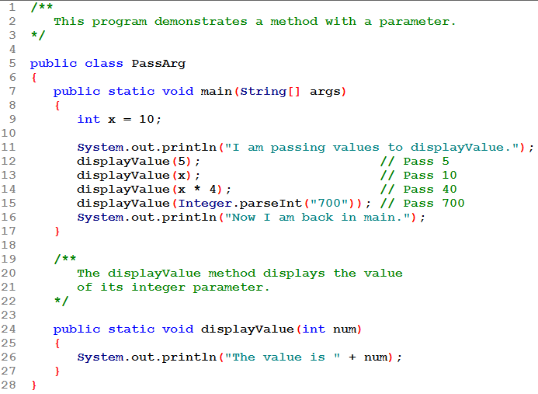
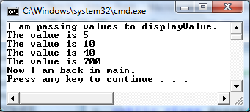
The displayValue() method is called 4 times each with a different argument. Arguments are (1) integer constant, (2) integer variable, (3) integer expression, (4) integer-valued method call.
The parameter is num.

Slide 21
Argument and Parameter Data Type Compatibility
When you pass an argument to a method, be sure that the argument’s data type is compatible with the parameter variable’s data type.
So, for example, an int argument can be passed to a double parameter without problem. Recall this is a "widening" conversion.
5-<number>
Notes:
CHAPTER 5
Java Gaddis 4e

Slide 22
Argument and Parameter Data Type Compatibility
Java will automatically perform widening conversions, but "narrowing" conversions will cause a compiler error. So trying to pass a double argument to an int parameter is an error.
double d = 1.0;
displayValue(d);
Error! Can’t convert double to int
5-<number>
Notes:
CHAPTER 5
Java Gaddis 4e

Slide 23
Passing Multiple Arguments
When calling a method and passing multiple arguments:
  the number of arguments in the call must match the number of parameters in the definition
  the first argument will be used to initialize the first parameter, the second argument to initialize the second parameter, etc.
1-<number>
Notes:
CHAPTER 5
Java Gaddis 4e

Slide 24
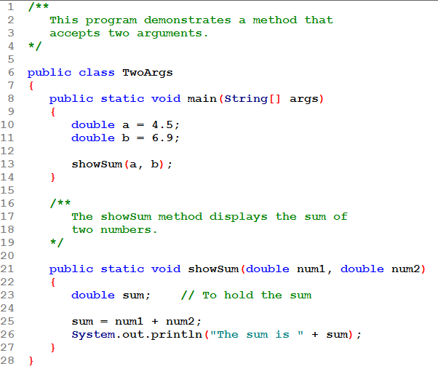
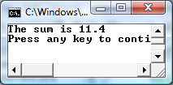
ARGUMENTS
PARAMETERS
The method call in line 13 passes
a and b as a arguments to the
method. Its parameters are num1, num2

Slide 25
Passing Multiple Arguments
The argument 5 is copied into the num1 parameter.
The argument 10 is copied into the num2 parameter.
showSum(5, 10);
public static void showSum(double num1, double num2)
{
  double sum; //to hold the sum
  sum = num1 + num2;
  System.out.println("The sum is " + sum);
}
NOTE: Order matters!
5-<number>
Notes:
CHAPTER 5
Java Gaddis 4e

Slide 26
Arguments are Passed by Value
In Java, all arguments of the primitive data types are passed by value, which means that only a copy of an argument’s value is passed into a parameter variable.
A method’s parameter variables are separate and distinct from the arguments that are listed inside the parentheses of a method call.
If a parameter variable is changed inside a method, it has no affect on the original argument.
See example: PassByValue.java
5-<number>
Notes:
CHAPTER 5
Java Gaddis 4e

Slide 27
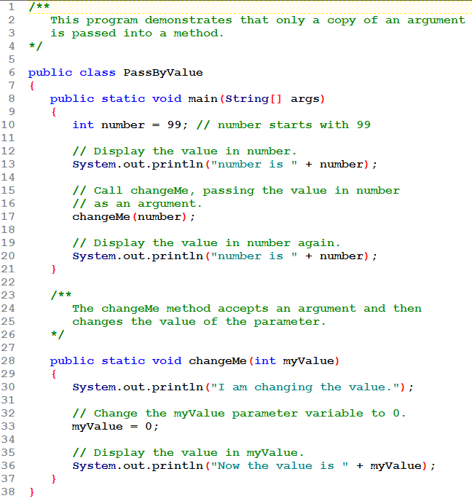
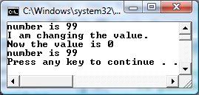
The argument, number is passed to param myValue. Changing myValue to 0 has no effect on the value of number.

Slide 28
Passing Object References to a Method
Recall that a class type variable does not hold the actual data item that is associated with it, but holds the memory address of the object. A variable associated with an object is called a reference variable.
When an object such as a String is passed as an argument, it is actually a reference to the object that is passed.
  That is, the address of the argument is passed to the parameter.
  So the argument and the parameter are referencing the same object!
5-<number>
Notes:
CHAPTER 5
Java Gaddis 4e

Slide 29
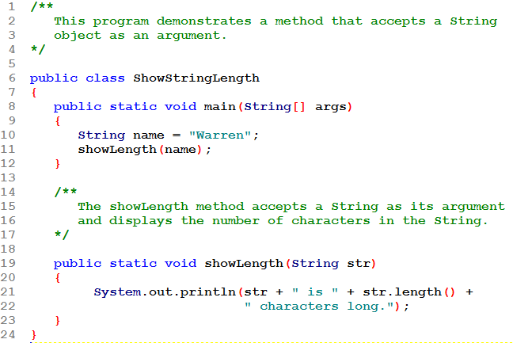

Both argument name and parameter str are references to the same String object.

Slide 30
Passing a Reference as an Argument
Both variables reference the same object
showLength(name);
public static void showLength(String str)
{
System.out.println(str + " is " + str.length() + " characters long.");
}
“Warren”
address
The address of the object is copied into the str parameter.
address
5-<number>
Notes:
CHAPTER 5
Java Gaddis 4e

Slide 31
Strings are Immutable Objects
This might make you think you could change the contents of a String object passed to a method.
But in Java, Strings are immutable objects, which means that they cannot be changed.
*** Any time you use the = operator to assign a String value to a String reference variable, you are actually assigning a new address to it and it will now reference the new object.
See example: PassString.java
5-<number>
Notes:
CHAPTER 5
Java Gaddis 4e

Slide 32
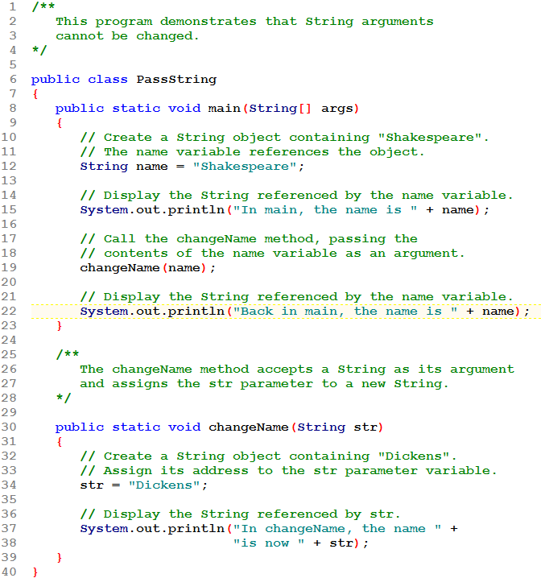
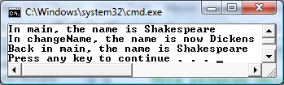
When str is assigned a new value, it doesn't change the contents of the object it points to. Instead it makes str point to a different object!

Slide 33
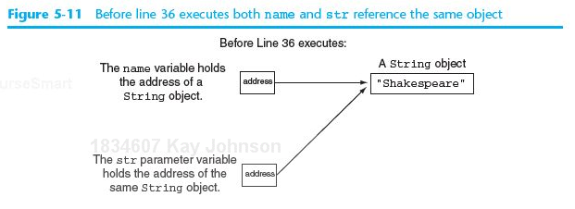
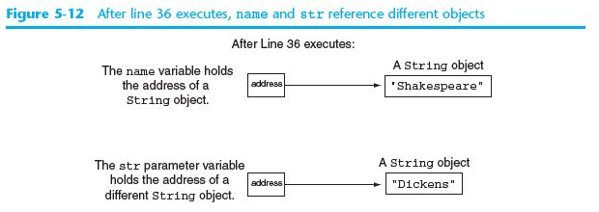
First name and str both point to the same object.
Now str has been assigned a new value and points to a different object.

Slide 34
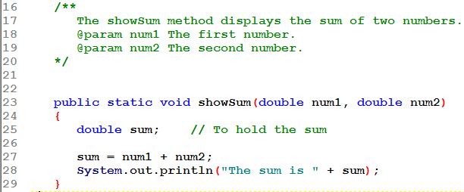
@param Tag in Documentation Comments
You can provide a description of each parameter in your documentation comments by using the @param tag.
5-<number>
Notes:
CHAPTER 5
Java Gaddis 4e

Slide 35
@param Tag in Documentation Comments
You can provide a description of each parameter in your documentation comments by using the @param tag.
General format
  @param parameterName Description
All @param tags in a method’s documentation comment must appear after the general description.
The description can span several lines. It ends at the end of the documentation comment (*/) or at the beginning of another tag.
5-<number>
Notes:
CHAPTER 5
Java Gaddis 4e

Slide 36
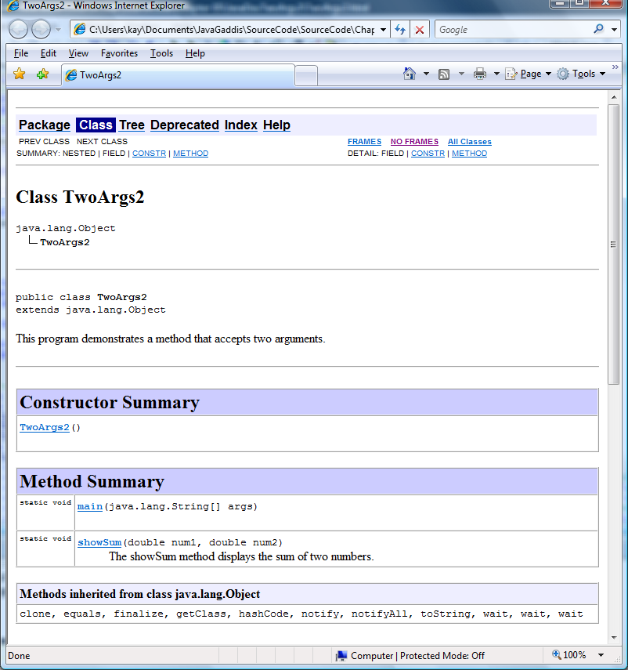
This is the JavaDoc results.
Method Summary section shows each method's header and, if included, the descriptive comments.

Slide 37
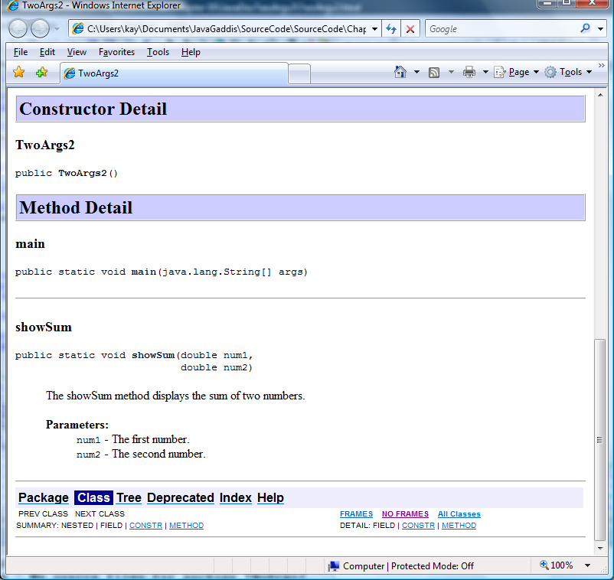
This is the JavaDoc results.
Method Detail section also shows the method's parameters, as documented by the @param tag.
showSum
documentation

Slide 38
More About Local Variables
Variables defined inside a method are local to that method . They are hidden from the statements in other methods, which cannot access them.
Local variables are not automatically initialized with a default value and must be given a value before they can be used.
Because the variables defined in a method are hidden, other methods may have separate, distinct variables with the same name.
We refer to the part of a program in which a variable is visible as that variable's scope.
1-<number>
Notes:
CHAPTER 5
Java Gaddis 4e

Slide 39
Scope and Lifetime/Duration
All variables have several attributes:
  name
  type
  size
  value
  duration
  scope
1-<number>

Slide 40
Scope and Lifetime/Duration
Scope defines where a variable can be used.
Local variables and parameters have block scope
  What is a block?
    a block is a code section enclosed in braces
    the body of a method is a block, the body of a loop is a block: anything enclosed by matching braces is a block
  Use only in the block where declared
  Use only after the line that declares them
1-<number>

Slide 41
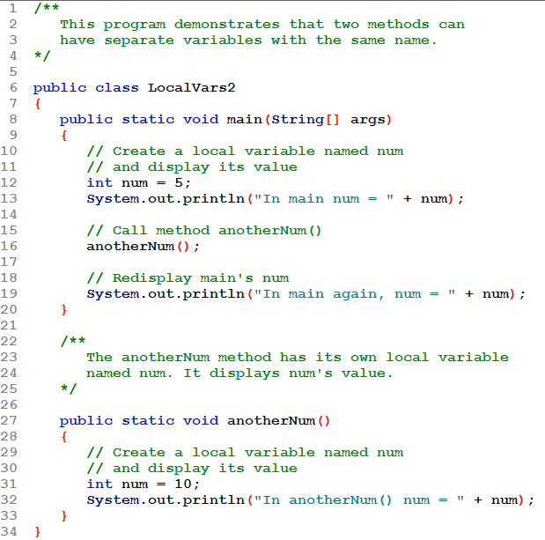
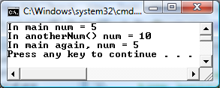
This num is visible only in main()
This num is visible only in anotherNum()

Slide 42
Scope and Lifetime/Duration
Lifetime/Duration defines when a variable is in memory.
Local variables and parameters
  placed into memory when the block they are declared in is entered
  remain in memory while that block is active
  This means that any value stored in a local variable is lost between calls to the method in which the variable is declared.
1-<number>

Slide 43
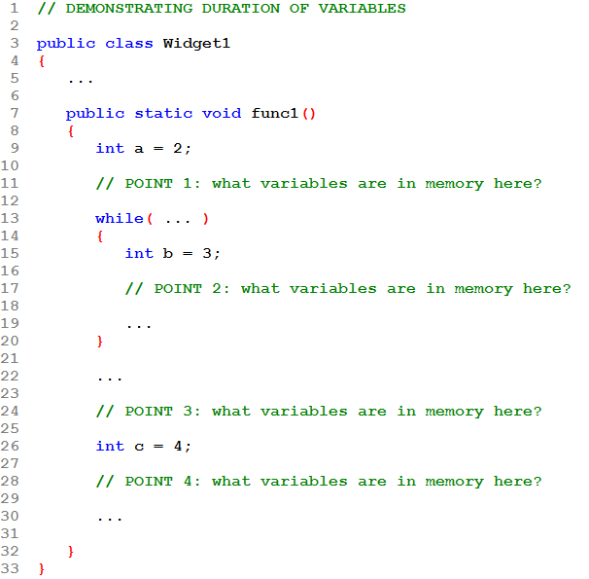
POINT 1:______
POINT 2: ______
POINT 3: ______
POINT 4: ______

Slide 44
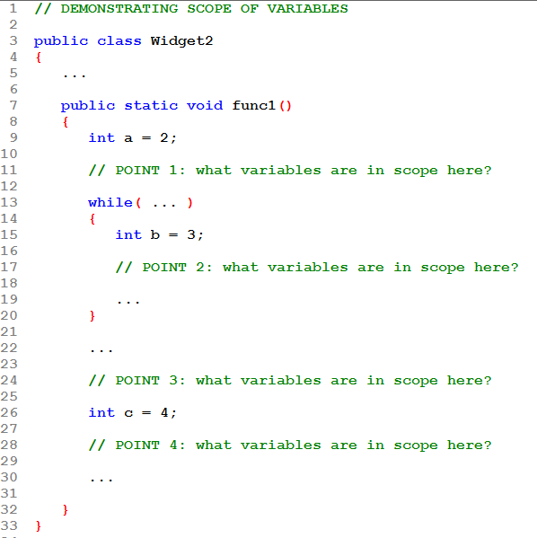
POINT 1:______
POINT 2: ______
POINT 3: ______
POINT 4: ______

Slide 45
The return Statement
Used to end execution of a method
Can be placed anywhere in a method
  Statements that follow the return statement will not be executed
Can be used to prevent abnormal termination of program
In a void method without a return statement, the method ends at its closing brace.
1-<number>
Notes:
CHAPTER 5
Java Gaddis 4e

Slide 46
The return Statement
Best practice: Have only 1 return statement in a method.
Pragmatic practice: Have extra return statements to handle error conditions; still have just 1 "normal" return.
1-<number>
Notes:
CHAPTER 5
Java Gaddis 4e

Slide 47
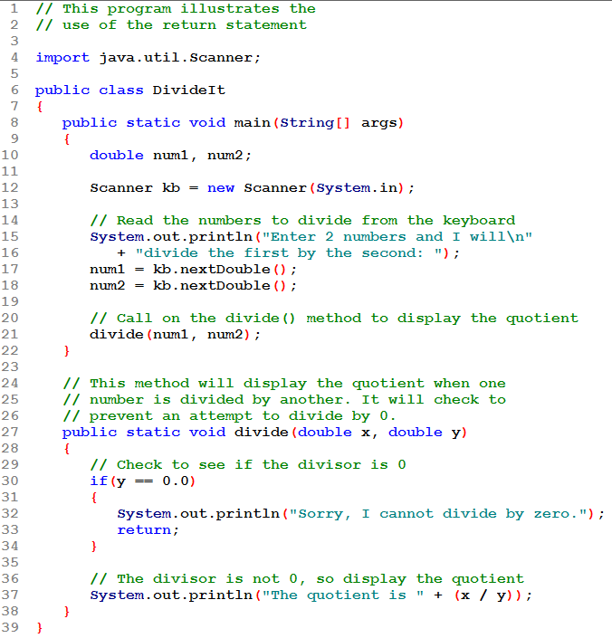
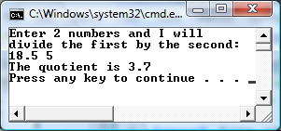
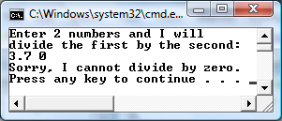
Once the return executes, the method ends! No more statements in it execute.
1-<number>

Slide 48
Returning a Value from a Method
Data can be passed into a method by way of the parameter variables. Data may also be returned from a method, back to the statement that called it.
int num = Integer.parseInt("700");
The string "700" is passed into the parseInt method ("700" is the argument).
The int value 700 is returned from the method and assigned to the num variable.
5-<number>
Notes:
CHAPTER 5
Java Gaddis 4e

Slide 49
Returning a Value From a Method
In a value-returning method, the return statement can be used to return a value from the method to the point of call. Example:
public static int sum(int num1, int num2)
{
int result;
result = num1 + num2;
return result;
}
1-<number>
Notes:
CHAPTER 5
Java Gaddis 4e

Slide 50
Defining a Value-Returning Method
public static int sum(int num1, int num2)
{
int result;
result = num1 + num2;
return result;
}
Return type
The return statement causes the method to end execution and it returns a value back to the statement that called the method.
This expression must be of the same data type as the return type
5-<number>
Notes:
CHAPTER 5
Java Gaddis 4e

Slide 51
A Value-Returning Method
Methods can return:
  constants: return 0;
  variables: return result;
  expressions: return num1 + num2;
The value returned must be compatible with the return type of the method.
  Java will convert the returned value to the needed type if necessary and possible.
1-<number>

Slide 52
Calling a Value-Returning Method
It's important that the calling function use the returned value:
  assign it to a variable
  display it
  use it in an expression
5-<number>
Notes:
CHAPTER 5
Java Gaddis 4e

Slide 53
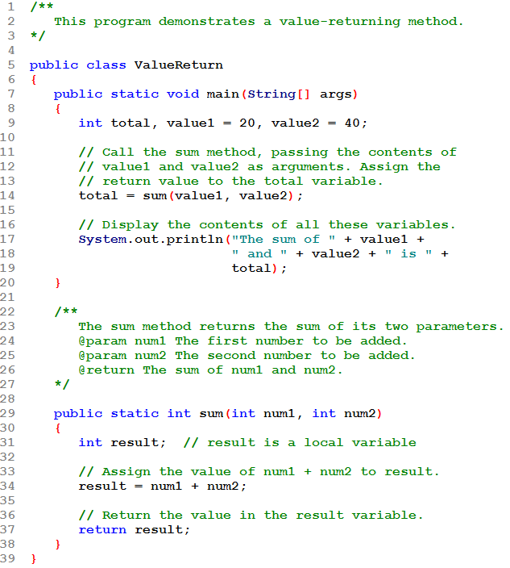
Be sure to use the returned value in an appropriate way.
Here the int return value is assigned to an int variable.

Slide 54
Calling a Value-Returning Method
total = sum(value1, value2);
  public static int sum(int num1, int num2)
  {
  int result;
  result = num1 + num2;
  return result;
  }
20
40
60
The parameters (num1, num2) get their values from the corresponding arguments (value1, value2). Then result is calculated. Its value is returned and assigned to total.
5-<number>
Notes:
CHAPTER 5
Java Gaddis 4e

Slide 55
@return Tag in Documentation Comments
You can provide a description of the return value in your documentation comments by using the @return tag.
General format
  @return Description
See example: ValueReturn.java
The @return tag in a method’s documentation comment must appear after the general description. The description can span several lines.
5-<number>
Notes:
CHAPTER 5
Java Gaddis 4e

Slide 57
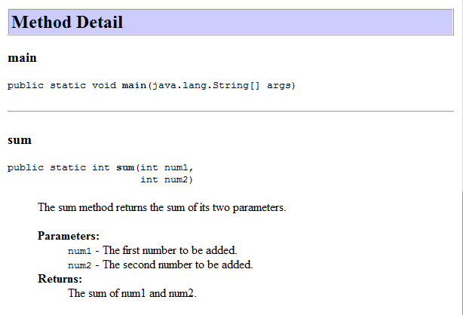
This is the JavaDoc results.
Method Detail section also shows the method's parameters, as documented by the @param tag.
and what it returns, as documented by the @return tag.

Slide 58
Demo Program: Using Methods
You are asked to write a program for a friend who frequently needs to convert from cups to fluid ounces.
Algorithm you design:
  Get the number of cups from the user
  Convert the cups to fluid ounces
  Display the cups and ounces
The algorithm becomes the basis of your class's main method.

Slide 59
Demo Program: Using Methods
Its steps are each implemented in its own method
  getCups()
    Get the number of cups from the user
    Prompts for and returns the number of cups
  cupsToOunces()
    Convert the cups to fluid ounces
    Pass in the number of cups; it returns the number of ounces
  displayResults()
    Display the cups and ounces
    Pass in the cups and ounces; it displays the results

Slide 60
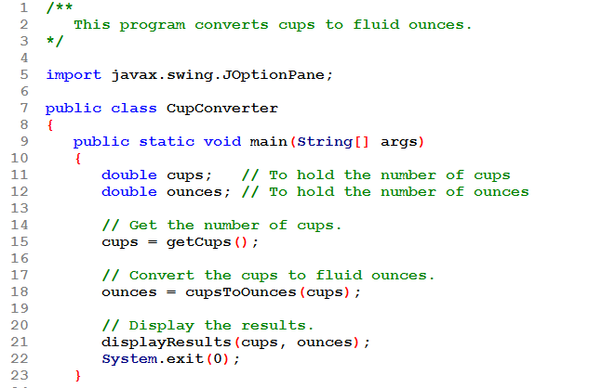
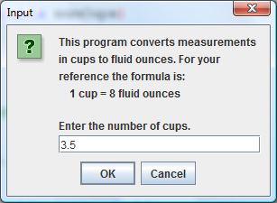
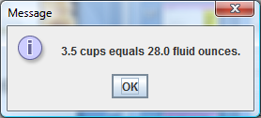
getCups() prompts and reads number of cups. The value it returns is assigned to variable cups.
cupsToOunces() is passed an cups and returns the equivalent number of ounces. The value is assigned to variable ounces.
displayResults() is passed cups and ounces. It displays them.

Slide 61
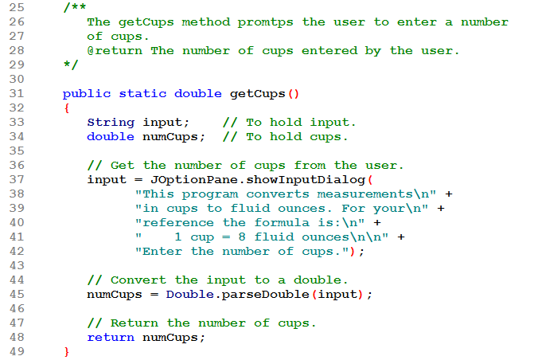
getCups() has no parameters.
It prompts and reads the number of cups.
It returns the number of cups, a double.

Slide 62
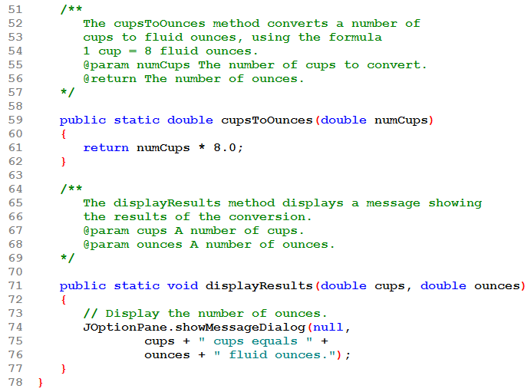
cupsToOunces() has one parameter: number of cups.
It computes and returns the equivalent ounces, a double.
displayResults() has two parameters: cups and ounces.
It displays those values.
It doesn't return anything (it is a void method)

Slide 63
Returning a boolean Value
Method can return true or false
Declare return type as boolean
Method body must contain return statement(s) that return true or false
Calling methods can use return value in a relational expression
1-<number>
Notes:
CHAPTER 5
Java Gaddis 4e

Slide 64
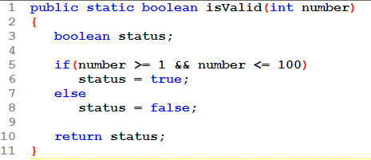
Returning a boolean Value
Example:
It returns true if the number is valid; false otherwise.

Slide 65
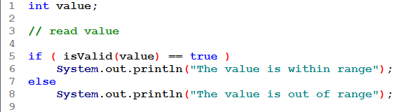
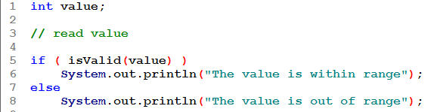
Returning a boolean Value
How to call the function:
Also:

Slide 66
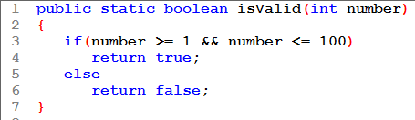
Returning a boolean Value
The method could be written other ways:
removes the status variable and uses 2 return statements.
  Not good software design: Best not to have more than 1 return from a method.

Slide 67
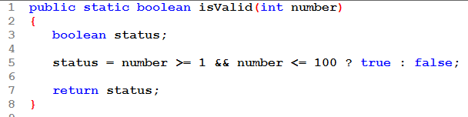
Returning a boolean Value
The method could be written other ways:
uses the conditional operator instead of an if statement.

Slide 68

Returning a boolean Value
The method could be written other ways:
returns the value of a boolean expression
  No local variable needed
  No if statement needed
  No conditional operator needed

Slide 69
Returning a Non-Primitive
It is also possible to return a non-primitive type, such as a String object.
What is actually returned is a reference to the object (i.e. the object's address is returned).

Slide 70
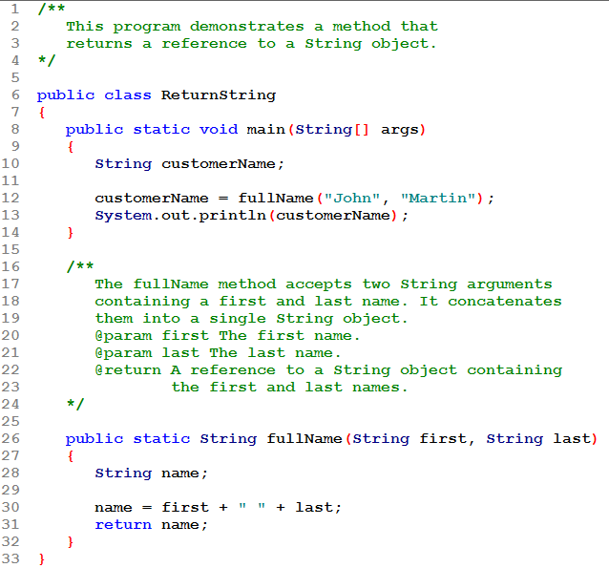
Passing in two Strings.
The method constructs a new String and returns it. What is actually returned is a reference to the new String (i.e. its address).

Slide 71
Returning a Reference to a String Object
customerName = fullName("John", "Martin");
public static String fullName(String first, String last)
{
String name;
name = first + " " + last;
return name;
}
See example:
ReturnString.java
address
Local variable name holds the reference to the object. The return statement sends a copy of the reference back to the call statement and it is stored in customerName.
“John Martin”
5-<number>
Notes:
CHAPTER 5
Java Gaddis 4e

Slide 72
Problem Solving with Methods
A large, complex problem can be solved a piece at a time by methods.
The process of breaking a problem down into smaller pieces is called functional decomposition.
Example: Read 30-days of sales amounts from a file and then display the total sales and average daily sales.
See example: SalesReport.java
5-<number>
Notes:
CHAPTER 5
Java Gaddis 4e

Slide 73
Problem Solving with Methods
Algorithm:
  Get the file name from the user
  Reading from the file, compute the total daily sales
  Calculate the average daily sales
  Display the total and average
Steps 1, 2, and 4 in this algorithm become methods in the solution.

Slide 74
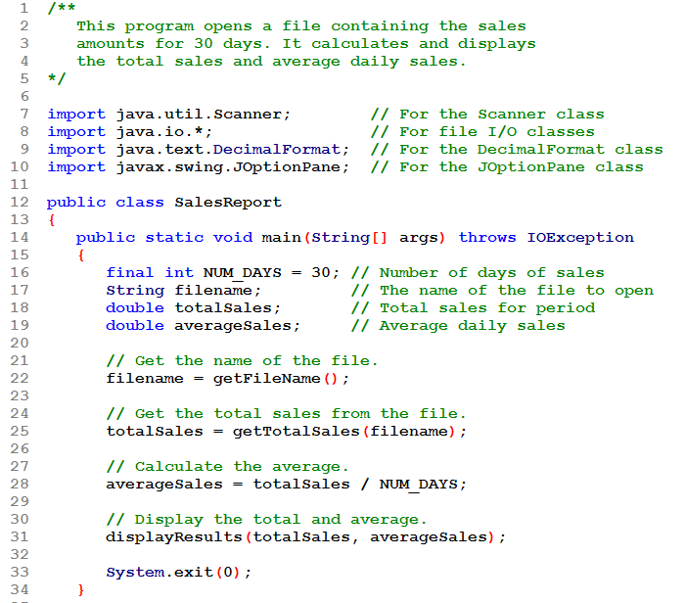
Method main is a "driver" that calls on each of the methods in the algorithm to solve the problem.

Slide 75
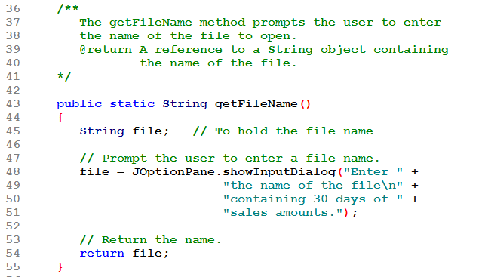
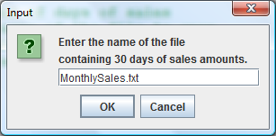
This method reads and returns a String that represents the file name.

Slide 76
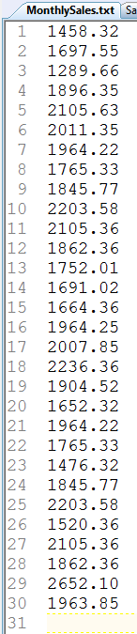
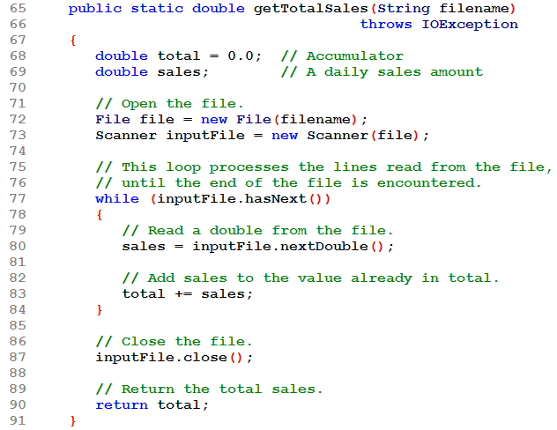
Deficiency: it doesn't check that the input file exists before using it!
This method is passed the file name. It then opens the file for reading. Then it loops until all records in the file have been read. In each iteration it reads a sales figure and adds it to the total. When the loop ends, it returns the total.

Slide 77
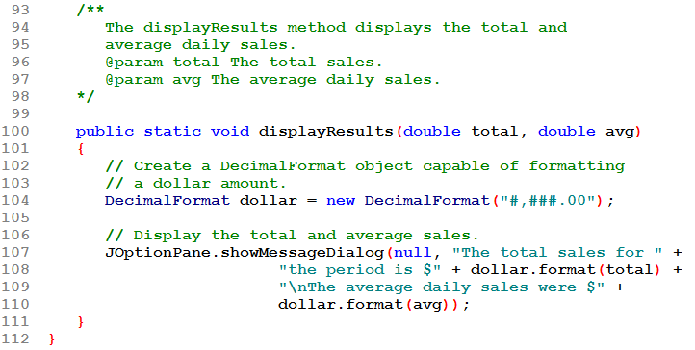
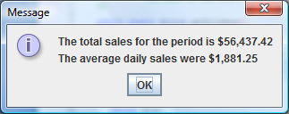
This method is passed the total and average which it formats as money and displays.

Slide 78
Calling Methods that Throw Exceptions
Note that the main and getTotalSales methods in SalesReport.java have a throws IOException clause.
All methods that use a Scanner object to open a file must throw or handle IOException.
It is only getTotalSales that uses the Scanner object.
  Clearly getTotalSales requires the throws IOException clause.
5-<number>
Notes:
CHAPTER 5
Java Gaddis 4e

Slide 79
Calling Methods that Throw Exceptions
Why is there also a throws IOException clause on main ?
  main calls getTotalSales. If getTotalSales throws an IOException, it is caught by its caller, main. So main must either handle the IOException or rethrow it.
  If a method calls another method that has a throws clause in its header, then the calling method must either handle the exception or have the same throws clause.
5-<number>
Notes:
CHAPTER 5
Java Gaddis 4e

Slide 80
END CHAPTER 5

